Slide 1


Slide 2







Slide 3



Slide 4
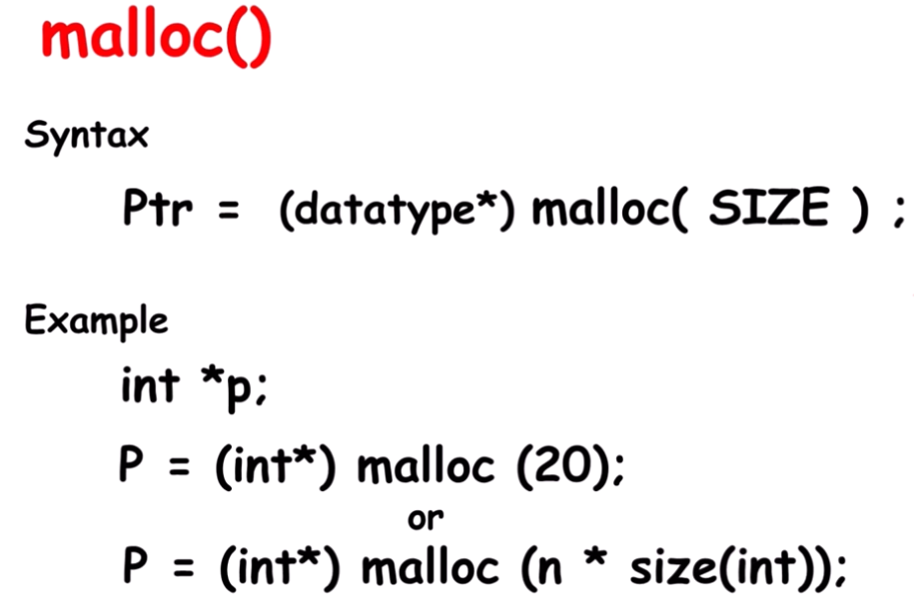
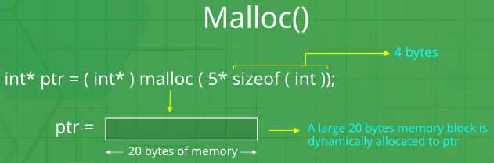
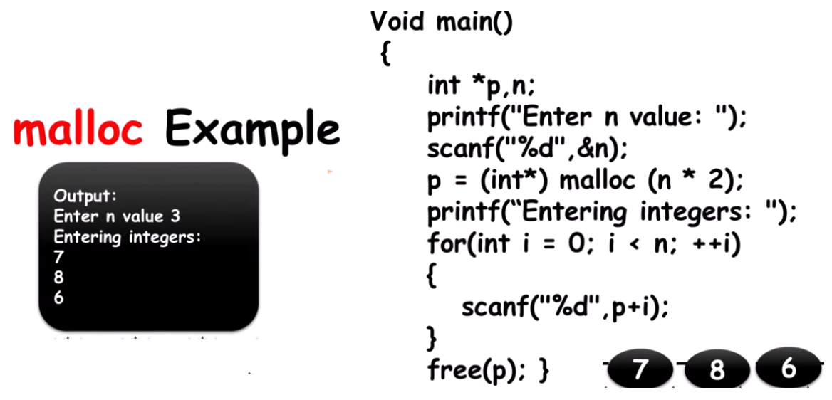
What is malloc used for in C?
Malloc is used for dynamic memory allocation and is useful when you don't know the amount of memory needed during compile time. Allocating memory allows objects to exist beyond the scope of the current block. C passes by value instead of reference.

Slide 5
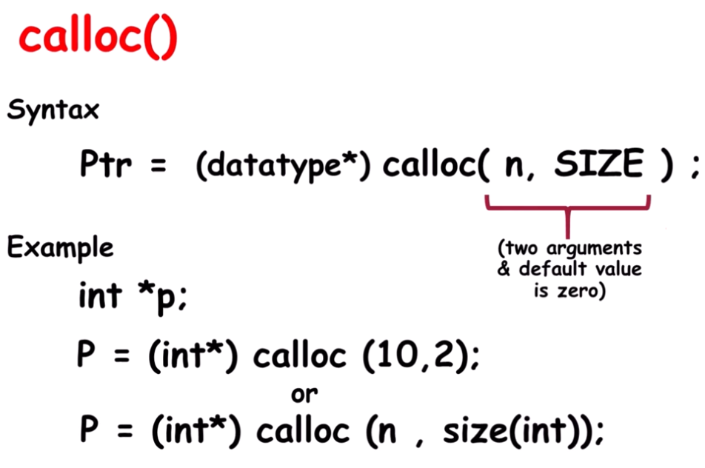
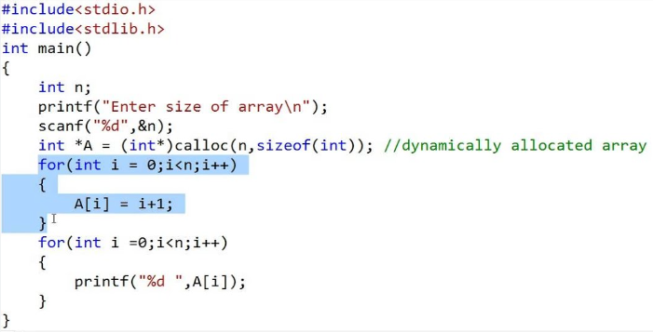
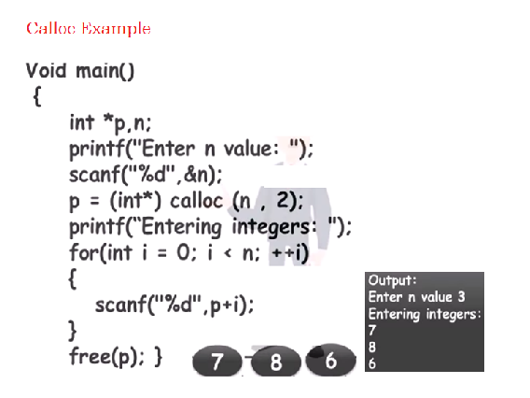
What is calloc in C programming?
“calloc” or “contiguous allocation” method in C is used to dynamically allocate the specified number of blocks of memory of the specified type

Slide 6
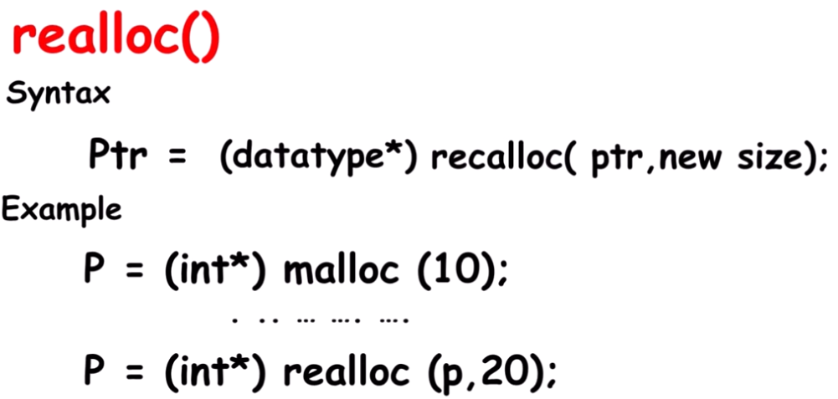
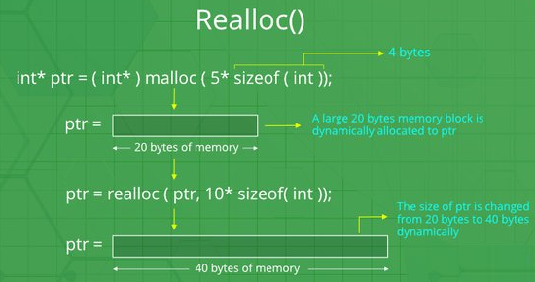
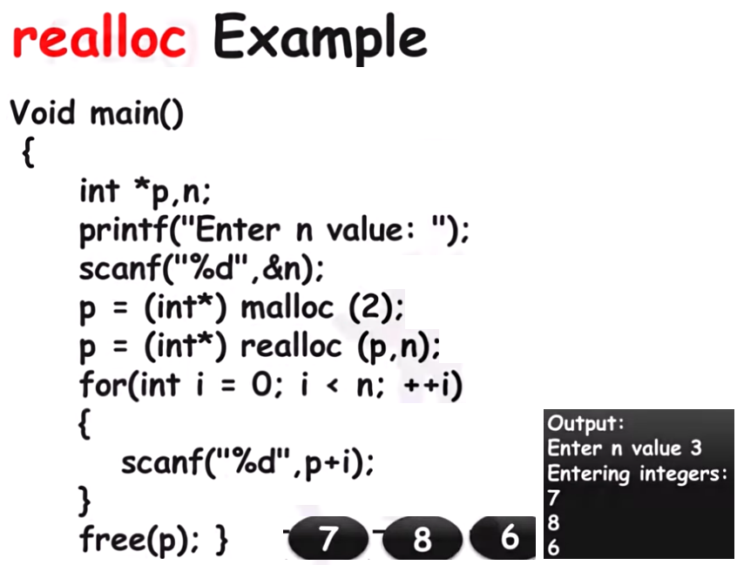

Slide 7
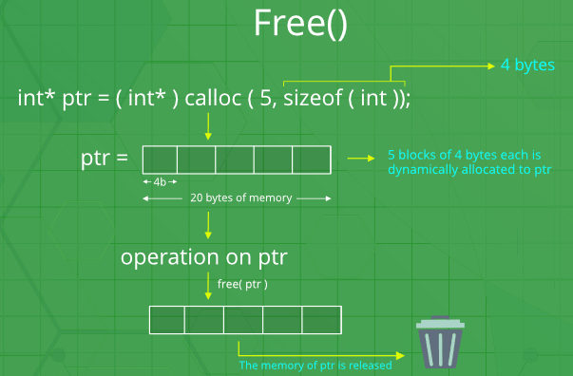
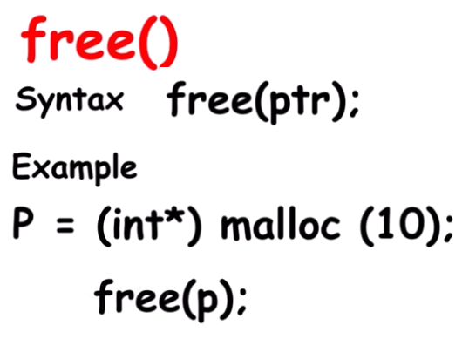

Slide 8
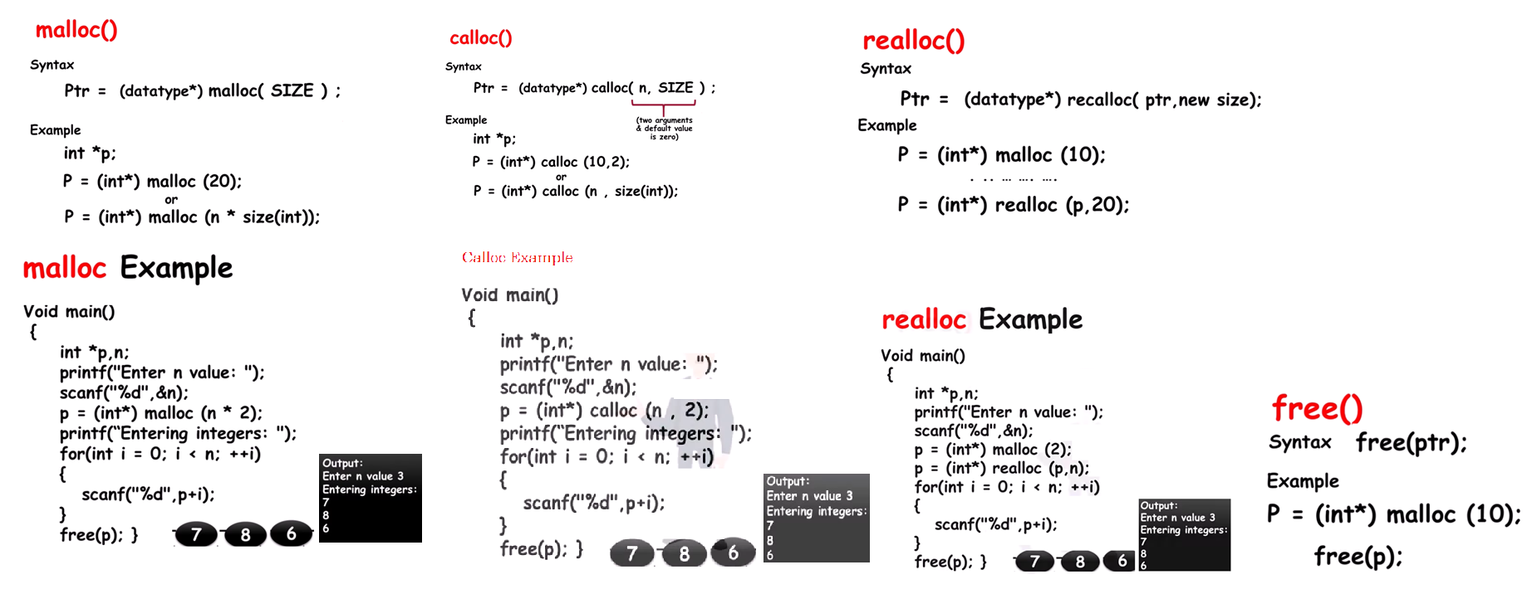

Difference Between Malloc and Calloc is that calloc allocates the memory and initializes every byte in the allocated memory to 0. In contrast, malloc allocates a memory block of a given size and doesn't initialize the allocated memory.

